Slide 1
KAGGLE REPORT(2024) STAT 642/ 674
TEAM MEMBERS:
VEDANT DERE
ISHANK SETHI
KRATI BAKLIWAL

Slide 2
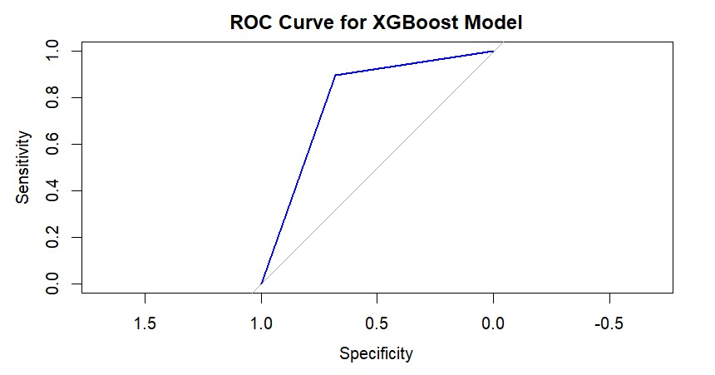
Data understanding
Background: Addresses the challenge of predicting customer churn for a large online store, where approximately 90% of customers do not return.
Goal: To develop a classification model to predict customers who are likely not to return, enabling the company to take proactive measures for retention.
The curve is close to the top-left corner, indicating the XGBoost model has excellent performance in distinguishing between the two classes.
The (AUC) appears to be very high, close to 1.0. A higher AUC value indicates better overall performance of the model.
The curve's shape suggests that the model can achieve a high true positive rate (sensitivity) while maintaining a low false positive rate (1 - specificity), which is desirable in many classification tasks.

Slide 3
DATA PREPARATION
.
To guarantee data quality, columns were checked for duplicate entries and missing values. Stratified sampling was used to ease the class imbalance in the target variable ('churn’).
Categorical variables were transformed into factors, and datasets were divided into training and testing sets
XGBoost Model Parameters:- nrounds: Determines the number of boosting rounds.
Setting nrounds (70): Allows the model to iteratively refine its predictions and improve performance over multiple iterations.
Low learning rate eta (0.01): Sets a low learning rate to ensure cautious steps in gradient descent, facilitating finer adjustments during model training and potentially enhancing convergence.
Max _Depth (3): Restricts the depth of each tree in the ensemble, mitigating overfitting by promoting simpler, more interpretable models while maintaining predictive power.
Original - Categorical variables were transformed into factors, and datasets were divided into training and testing sets.
New - Target variable was transformed into factor as its essential for categorical classification tasks and training dataset was divided into train and test to ensure accuracy.

Slide 4
DATA MODELING
The model used in this scenario is an XGBoost model, which stands for eXtreme Gradient Boosting.
In our project, We chose XGBoost for its unparalleled predictive accuracy, scalability to handle large datasets efficiently, and its ability to provide insights into feature importance, crucial for understanding complex relationships between variables and driving actionable business decisions.
Achieved a high accuracy ranging from 85-91 percent on the training dataset.
Confusion matrix analysis showing counts of true negatives (72), false positives (34), false negatives (698), and true positives (5967).
An ROC (Receiver Operating Characteristic) ranging from 75% to 84% in training dataset indicates the model's ability to distinguish between classes, with higher values suggesting better discrimination performance.

Slide 5
EVALUATION METHODOLOGY
Accuracy: The model achieves an accuracy of approximately 89.19%, indicating that it correctly predicts churn status for about 89.19% of the instances.
AUC (Area Under the ROC Curve): The AUC for the XGBoost model is approximately 0.787, reflecting its moderate ability to discriminate between customers likely to churn and those who are not.
Confusion Matrix: The confusion matrix shows the distribution of true negatives (72), false positives (34), false negatives (698), and true positives (5967), revealing the model's performance across different prediction outcomes.
Mcnemar's Test P-Value: The p-value for Mcnemar's test is less than 2e-16, indicating a significant difference between predicted and actual churn classifications, suggesting potential model improvement opportunities.

Slide 6
Managerial implications
Targeted Marketing: Apply the approach to target and improve engagement and retention by personalizing marketing campaigns for clients who pose a risk.
Resource Optimization: Target high-value clients with retention tactics to increase productivity and profits.
Customer Experience: Increase satisfaction by addressing the model-identified churn drivers and improving the quality and offerings of products and services.
Input Integration: For ongoing development and competitiveness, include churned client input.
LIMITATIONs
Data Quality: Good data is necessary for accurate predictions. Data that is incomplete can generate bias.
Dynamic Behavior: Over time, customer behavior varies, which has an impact on the correctness of the model. It needs to change to fit new patterns.
Overfitting: To reduce their capacity to generalize to new data, complex models may absorb noise from training data.
Ethical Considerations: To keep people's trust, models need to uphold moral principles like justice and privacy.
Interpretability: It's critical for stakeholder comprehension to strike a balance between model complexity and interpretability.

